Slide 1
Scene Text Recognition with Permuted Autoregressive Sequence Models
ECCV 2022
AUTHOR：Darwin Bautista, Rowel Atienza
REPORTER : 鄧仲恩
NTUST GAMELab cs.CV cs.CL
Notes:
具有置換自回歸序列模型的場景文本識別。

Slide 2
Outline
Introduction
Related Work
Permuted Autoregressive Sequence Models
Results and Analysis
Conclusion
NTUST GAMELab cs.CV cs.CL

Slide 3
Introduction
3
NTUST GAMELab cs.CV cs.CL

Slide 4
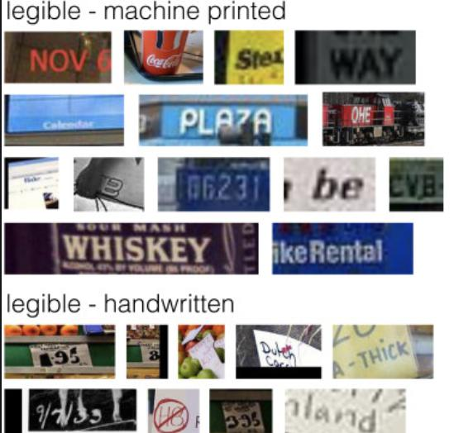
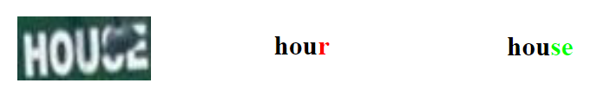
Introduction - STR
What is Scene Text Recognition(STR)?
Context-aware STR a) word representation model (SEED) b) dictionary c) learned from data (CRNN、TRBA) d) sequence modeling (Transformer)
NTUST GAMELab cs.CV cs.CL
Notes:
road signs, bill- boards, paper bills, product labels, logos, printed shirts
self-driving cars, augmented reality, retail, education, and devices

Slide 5
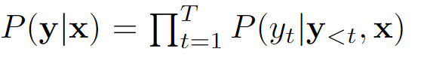


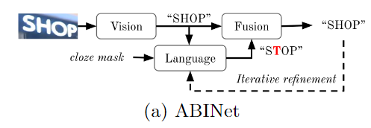
Introduction -limitation
Prior STR methods limitation.
Prior works address these limitations. a) Combined left-to-right and right-to-left. b) Combined context-free vision and context-aware language models.
NTUST GAMELab cs.CV cs.CL
Notes:
a) 還是兩個單向辨識結果 最後組合 增加辨識時間與複雜度
b) spell checker! 在初步辨識如果有錯字較多時 難以糾正回來 SRN (27.6%) ABINet (41.9%) -> fusion layer
ABINet LM效率低下
PI

Slide 6
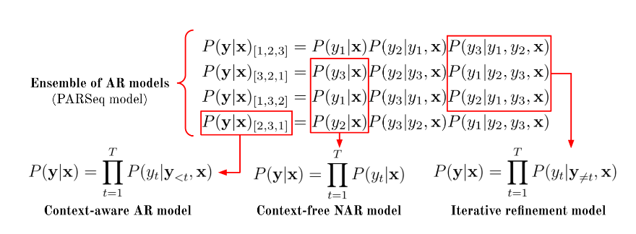
Introduction-PLM
Permutation Language Modeling (PLM) →Attention Masks
PARSeq achieves SOTA results on the STR benchmarks.
NTUST GAMELab cs.CV cs.CL

Slide 7
Related Work
7
NTUST GAMELab cs.CV cs.CL

Slide 8
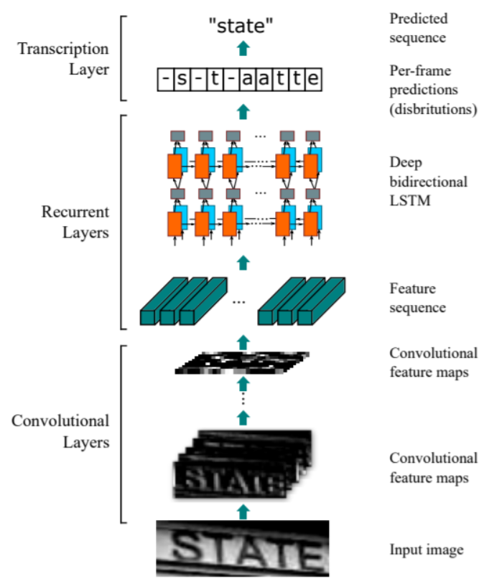
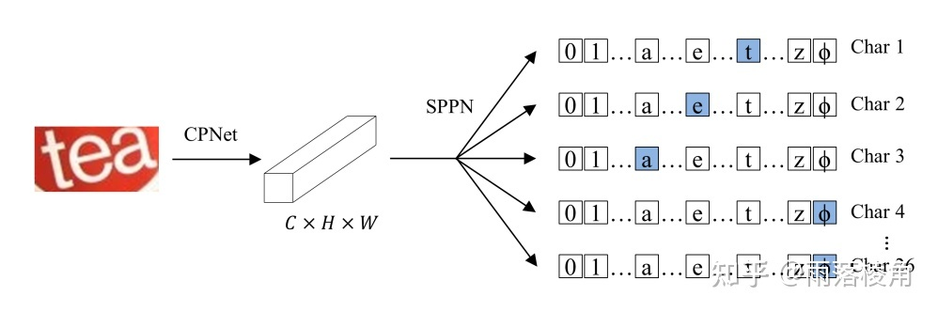
Related Work-Context-free STR
Directly predict the characters from image.
CTC-based (CRNN、STAR-Net) +Self-attention
As a multi-instance classification. (SCTR)
Use an attention mechanism to produce the initial context-less predictions.(ABINet)
NTUST GAMELab cs.CV cs.CL

Slide 9
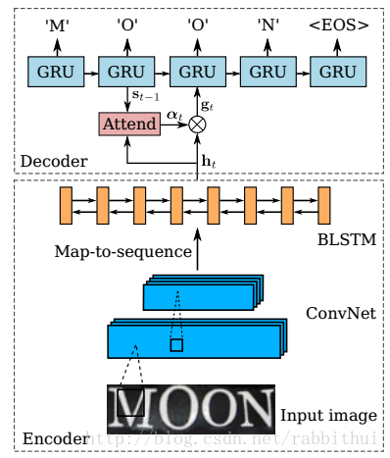
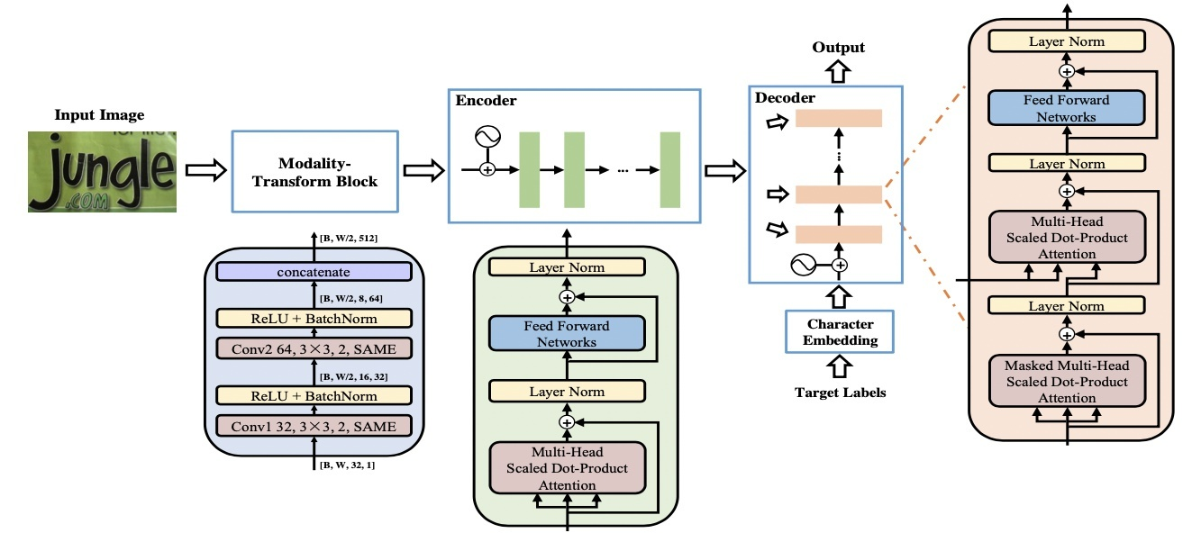
Related Work-Context-aware STR
Use semantics learned from data to aid in recognition.
RNNs with attention(R2AM、RARE)
Transformers(NRTR)
Bidirectional context via an external LM.(ABINet)
NTUST GAMELab cs.CV cs.CL
Notes:
1.2. learn internal LMs using the standard AR training -> These methods are limited to monotonic AR decoding.
3. 易改錯

Slide 10
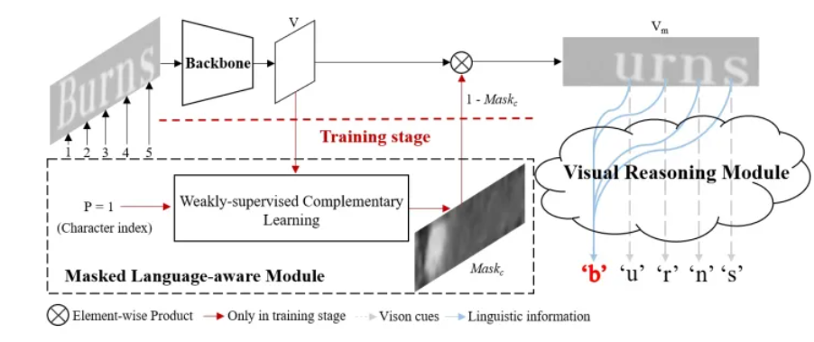
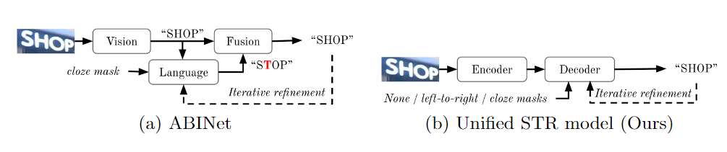
Related Work-Context-aware STR
VisionLAN, Masked Language Modeling.
ABINet
NTUST GAMELab cs.CV cs.CL
Notes:
SARSeq learns an internal LM using PLM .
Cloze context for both training and inference, iterative refinement only

Slide 11
Related Work-Generation from Sequence Models
autoregressive (one token at a time) and
non-autoregressive (all tokens predicted at once)
BANG adapted two-stream attention for use MLM.
PMLM is trained using MLM where the masking ratio is stochastic.
Tian et al. which adapts the two-stream attention parameterization to decoders by interspersing the content and query streams from different layers.
NTUST GAMELab cs.CV cs.CL
Notes:
本頁尚有缺漏 有空要回來補
Mask language model
Stochastic 隨機

Slide 12
Permuted Autoregressive Sequence Models
12
NTUST GAMELab cs.CV cs.CL

Slide 13

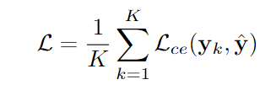

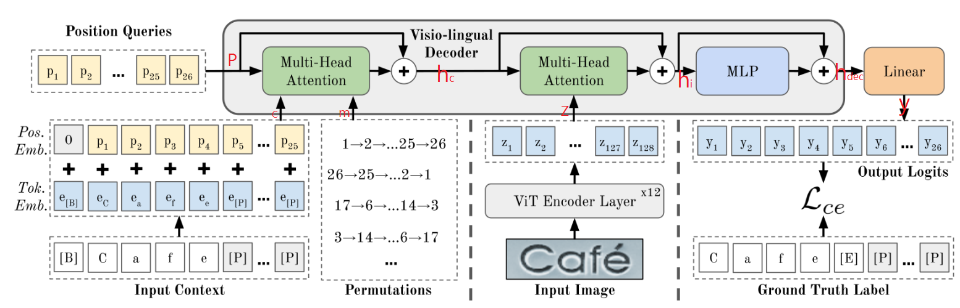



Permuted Autoregressive Sequence Models - Model Architecture
1
3
2
NTUST GAMELab cs.CV cs.CL
Notes:
p:position tokens
c:c+p context embeddings with positional information
m: optional attention mask
S: is the size of the character set

Slide 14
Permuted Autoregressive Sequence Models - Model Architecture
NTUST GAMELab cs.CV cs.CL
Notes:
p:position tokens
c:c+p context embeddings with positional information
m: optional attention mask
S: is the size of the character set

Slide 15

Permuted Autoregressive Sequence Models - Model Architecture
NTUST GAMELab cs.CV cs.CL
Notes:
p:position tokens
c:c+p context embeddings with positional information
m: optional attention mask
S: is the size of the character set

Slide 16
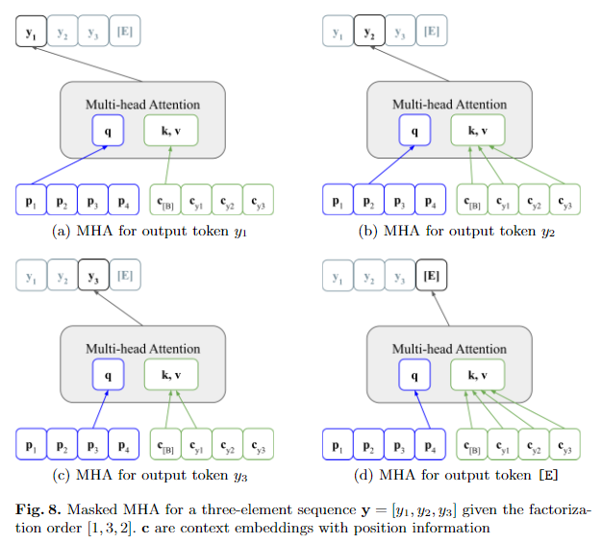
Permuted Autoregressive Sequence Models - Model Architecture
NTUST GAMELab cs.CV cs.CL

Slide 17
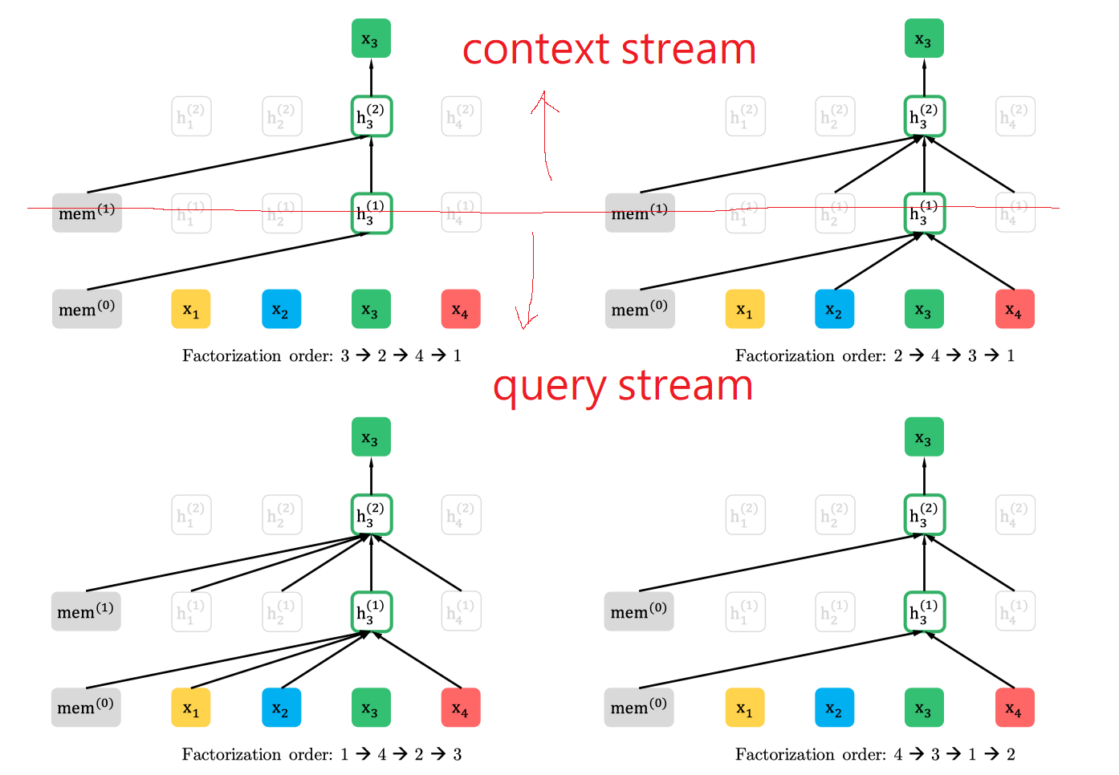
Permuted Autoregressive Sequence Models - Model Architecture
XLNet Generalized Autoregressive Pretraining for Language Understanding
NTUST GAMELab cs.CV cs.CL

Slide 18
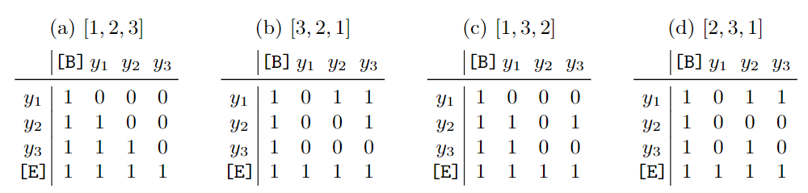

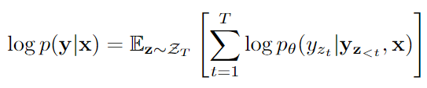
Permuted Autoregressive Sequence Models - Permutation Language Modeling
Use K of the possible T!.
In practice, we cannot train on all T!
NTUST GAMELab cs.CV cs.CL
Notes:
ZT denotes the set of all possible permutations
first half consists of theleft-to-rightpermutation, [1, 2, . . . ,T], andK/2−1 randomly sampled permutations

Slide 19
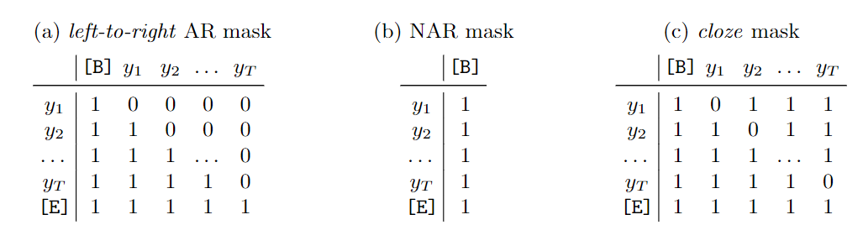
Permuted Autoregressive Sequence Models - Decoding Schemes
Autoregressive, first iteration context is set to [B]
Non-autoregressive, context is always [B]
Iterative refinement, similar to AR decoding
NTUST GAMELab cs.CV cs.CL
Notes:
first iteration, the context is set to [B] and only the first position query token p1 is used while the context is set to the previous output

Slide 20
Results and Analysis
20
NTUST GAMELab cs.CV cs.CL

Slide 21
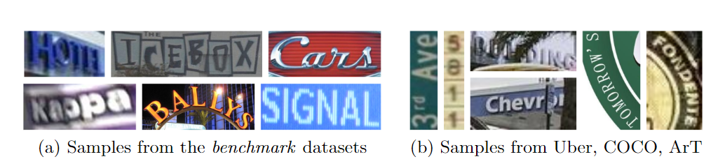
Results and Analysis-Datasets
Train
Synthetic datasets : MJSynth 、SynthText
Real data : COCO-Text、RCTW17、Uber-Text、ArT、SVT、MLT19、ReCTS
Recent large-scale real datasets : TextOCR
Evaluation
IIIT 5k-word, CUTE80, Street View Text, SVT-Perspective, ICDAR 2013, ICDAR 2015
NTUST GAMELab cs.CV cs.CL

Slide 22
Results and Analysis-Training Protocol and Model Selection
batch size of 384
169,680 iterations
Adam with 1 cycle learning rate schedule
At iteration 127,260 (75% of total) -> Stochastic Weight Averaging
K= 6 permutations
patch size : 8×4
label length T= 25
charset size S= 94
RandAugment
128×32 pixels
NTUST GAMELab cs.CV cs.CL

Slide 23
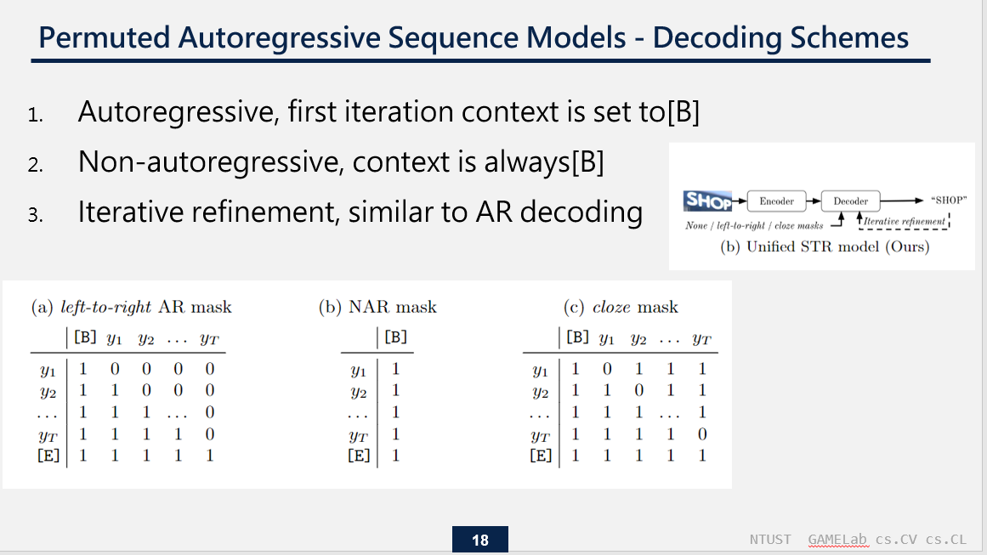
Results and Analysis-Evaluation Protocol and Metrics
NVIDIA Tesla A100 GPU system
PARSeq : using two different decoding schemes PARSeqA : denotes AR decoding with one refinement iteration PARSeqN : denotes NAR decoding with two refinement iterations
NTUST GAMELab cs.CV cs.CL

Slide 24
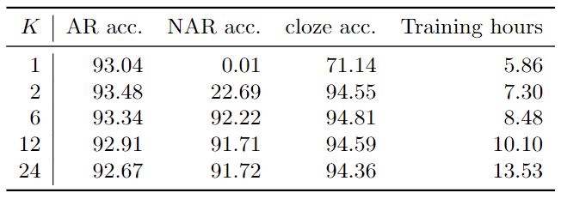
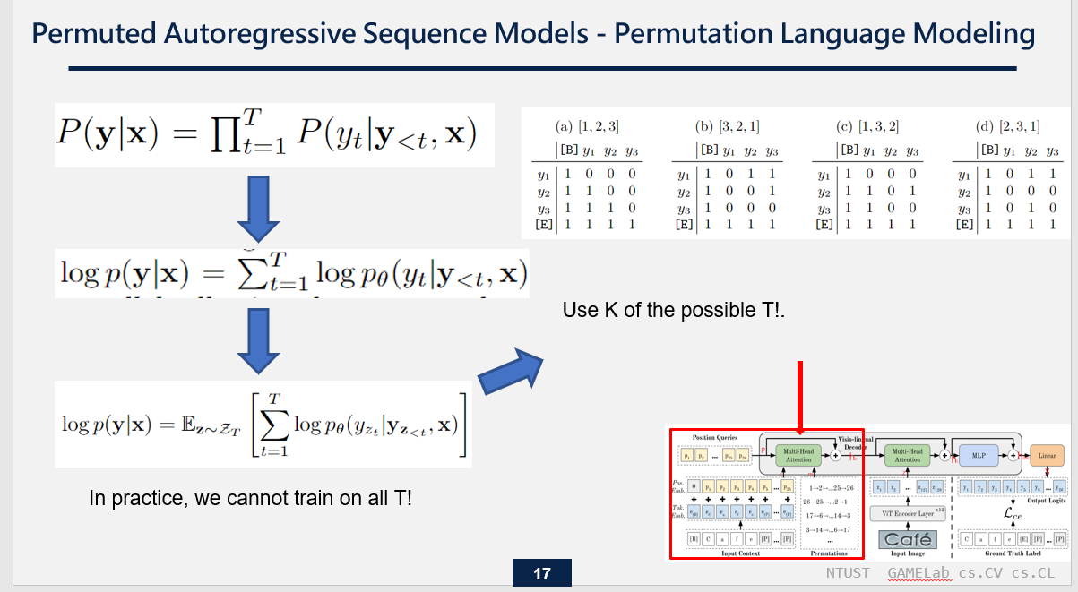
Results and Analysis-Ablation on training permutations vs test accuracy
NTUST GAMELab cs.CV cs.CL
Notes:
無法同時訓練T!
Cloze accuracy is at a dismal 71.14%(BAD)
K >= 6 才達標
K= 6 認為是最好 其在訓練時間與準確率取的一個好的平衡
The very high cloze accuracy (∼94%) of our internal LM highlights the advantage of jointly using image features and language context for prediction refinement

Slide 25
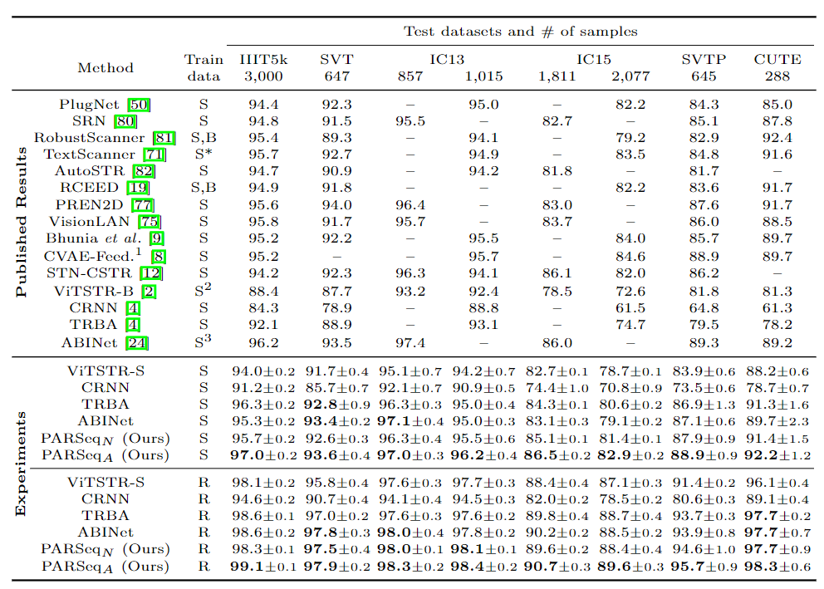
Results and Analysis - Comparison to SOTA
Synthetic datasets (S) - MJ and ST
Benchmark datasets (B) - SVT, IIIT5k, IC13, and IC15
Real datasets (R) - COCO, RCTW17, Uber, ArT, LSVT, MLT19, ReCTS, TextOCR, and OpenVINO
”*” denotes usage of character-level labels
1 Used with SCATTER
2 SynthText without special characters (5.5M samples).
3 LM pretrained on WikiText-103
NTUST GAMELab cs.CV cs.CL

Slide 26
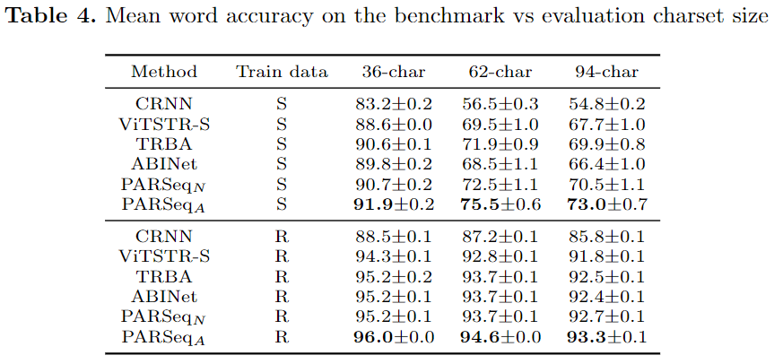
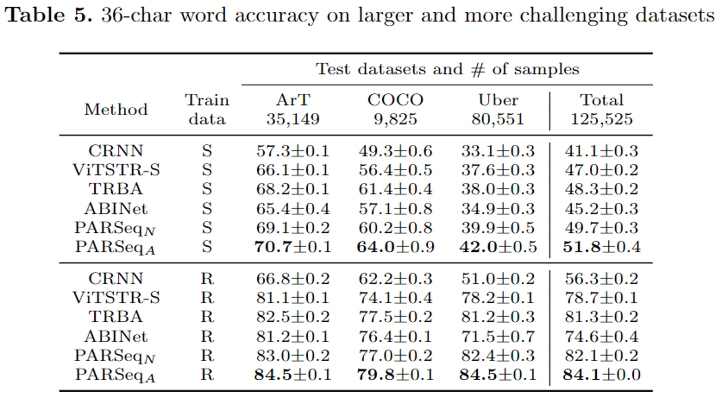
Results and Analysis - Comparison to SOTA
NTUST GAMELab cs.CV cs.CL
Notes:
4.
5. most robust against occlusion and text orientation variability.

Slide 27
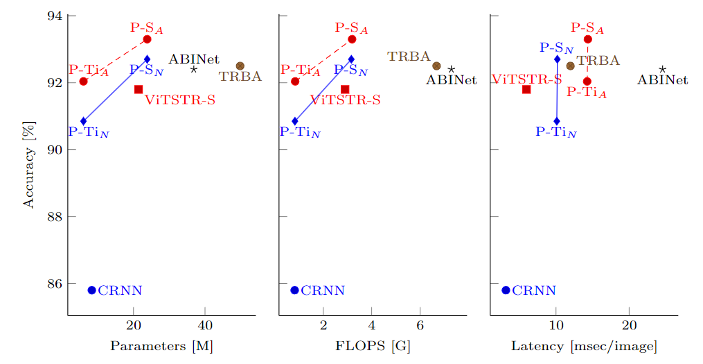
Results and Analysis - Comparison to SOTA
NTUST GAMELab cs.CV cs.CL

Slide 28
Conclusion
28
NTUST GAMELab cs.CV cs.CL

Slide 29
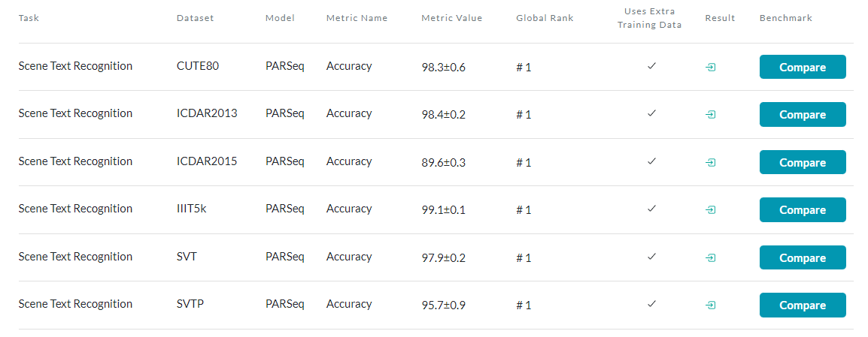
Conclusion
Adapted PLM for STR in order to learn PARSeq.
Unified STR model capable of context-free and -aware decoding.
PARSeq achieves SOTA results.
NTUST GAMELab cs.CV cs.CL

Slide 30
報告完畢 THE END
謝謝 Thank You
NTUST GAMELab cs.CV cs.CL

Slide 31
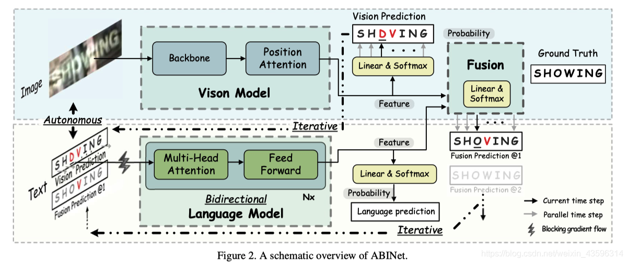
ABINet
NTUST GAMELab cs.CV cs.CL

Slide 32
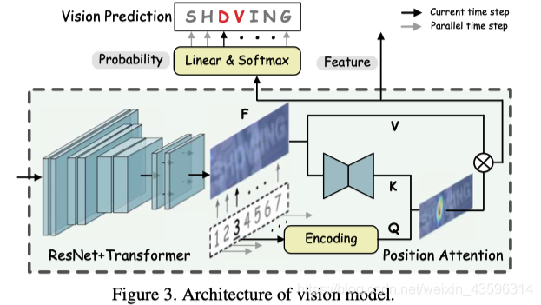
ABINet
NTUST GAMELab cs.CV cs.CL

Slide 33
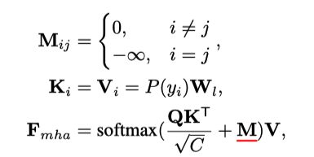
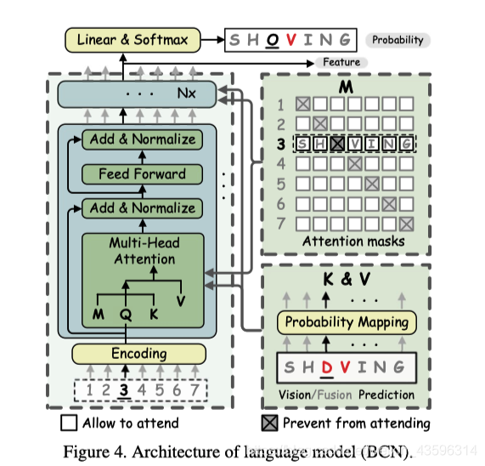
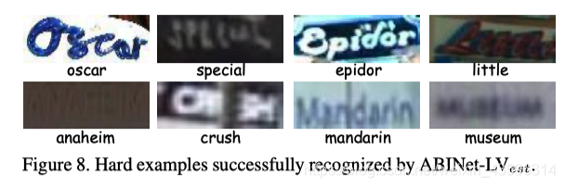
ABINet
NTUST GAMELab cs.CV cs.CL

Slide 34
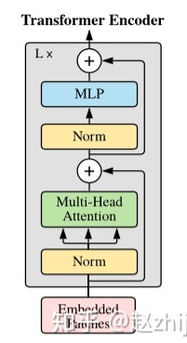
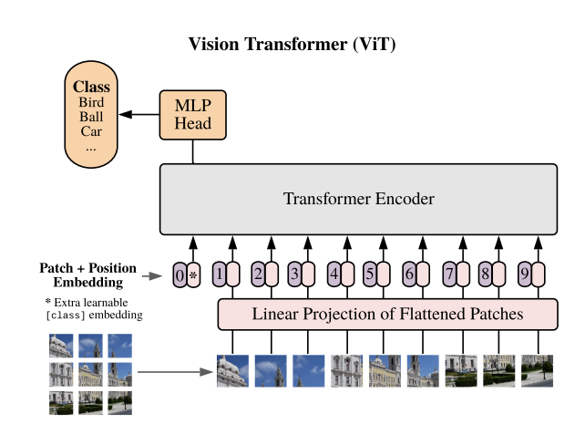

Slide 35
自評表
FAQ | 完成
1. Paper的Input / Process / Output是什麼? | ☑
2. Paper主要動機、目的、應用為何?如何應用到我們的研究?是否能應用到遊戲製作技巧上? | ☑
3. Paper的貢獻?最重要的貢獻?價值?厲害在哪裡?強在哪裡?好在哪裡?優點?方法?想法?為什麼要這樣用?有什麼特別的?困難的地方在哪?為什麼難?跟Previous Work之間的差異是什麼? | ☑
4. Paper的Framework? | ☑
5. Paper中專有名詞的定義和意義和有哪些和正確發音? | ☑
6. Paper中公式所代表的意義?物理意義?參數?為什麼要這樣定義的目的和原因? | ☑
7. Paper的缺點?限制?哪邊可以改進?我們有沒有辦法發表一個方法解決?
8. Results的圖/表意義和如何閱讀?足夠嗎?數據為什能夠比其他的Paper好?是否有作弊?特別美化?為什麼實驗要這樣設計?結果的意義? 作者要讓我們知道什麼?如何驗證結果?如何從Results驗證Paper提到的優點、好處、貢獻? | ☑
9. Paper是上什麼期刊?出處?Title的意思是什麼?被何人發表? | ☑
10. 讀完Paper之後你有沒有辦法實現?用程式寫出來? | ☑

Slide 36
What You’ve Learned
Critical technique:
Scene Text Recognition
Permuted Autoregressive Sequence Models
Transformer
Good math expression:
Recommended references:
All mentioned methods in this PPT.
Good experiment approach:
Other:

